Slide 1

Walmart Sales Prediction
Franck Ivan Ouambo Simo
Data Science Institute
12/12/2025
GitHub: Click Link

Slide 2
Agenda
Recap
Cross Validation
Introduction
Dataset/Problem Statement
EDA and Preprocessing
Splitting/CV
Algorithms/ Parameters
Results
Score(RMSE)/Baseline
Model Inspection
Model Interpretation
Steps
Outlook
Predictive Power Improvement

Slide 3
RECAP.....
Introduction:
-M5 Competition Dataset on Kaggle
-Predict a Walmart product’s Sales Tomorrow (Regression Problem !!)
Relevance:
- Storage Space Saving
- Labor Allocation in Stores
- Predicting Scaling needs

Slide 4
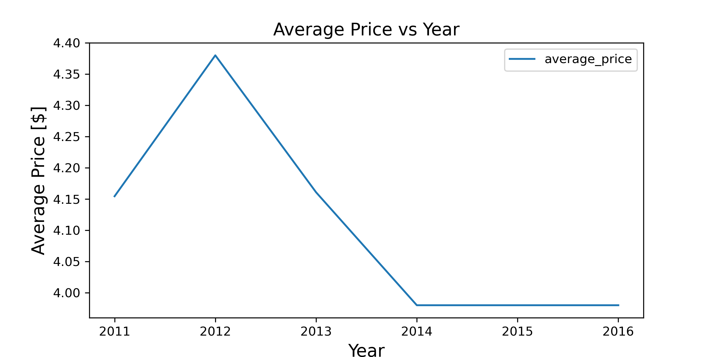
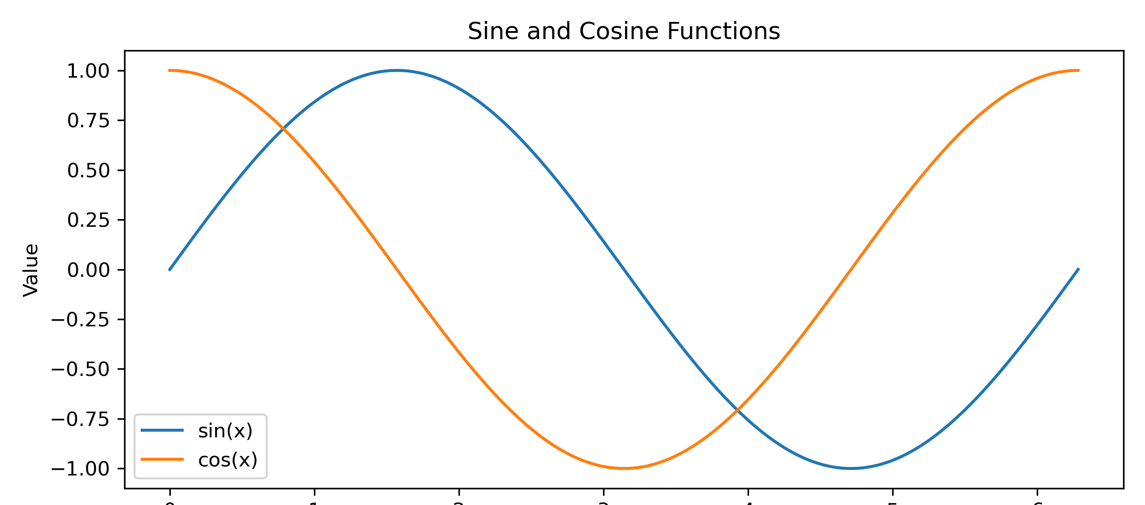
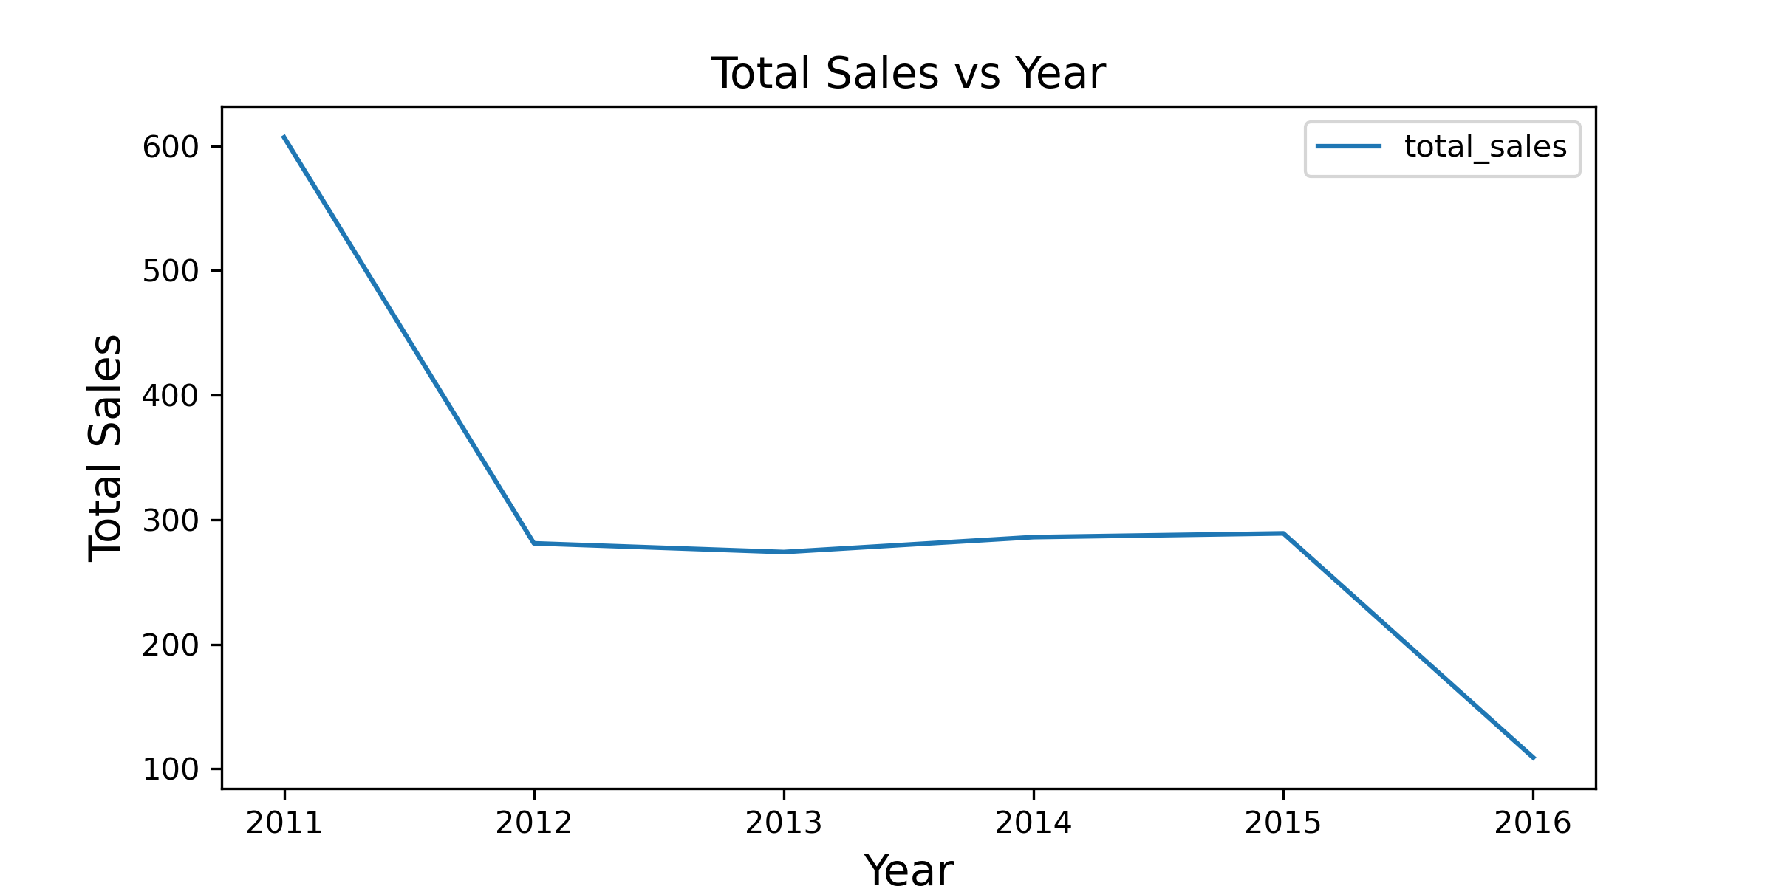
RECAP....
Interesting EDA/ preprocessing
Preprocessing :
-Encoded Month and Week features mapped to Sine and Cosine

Slide 5
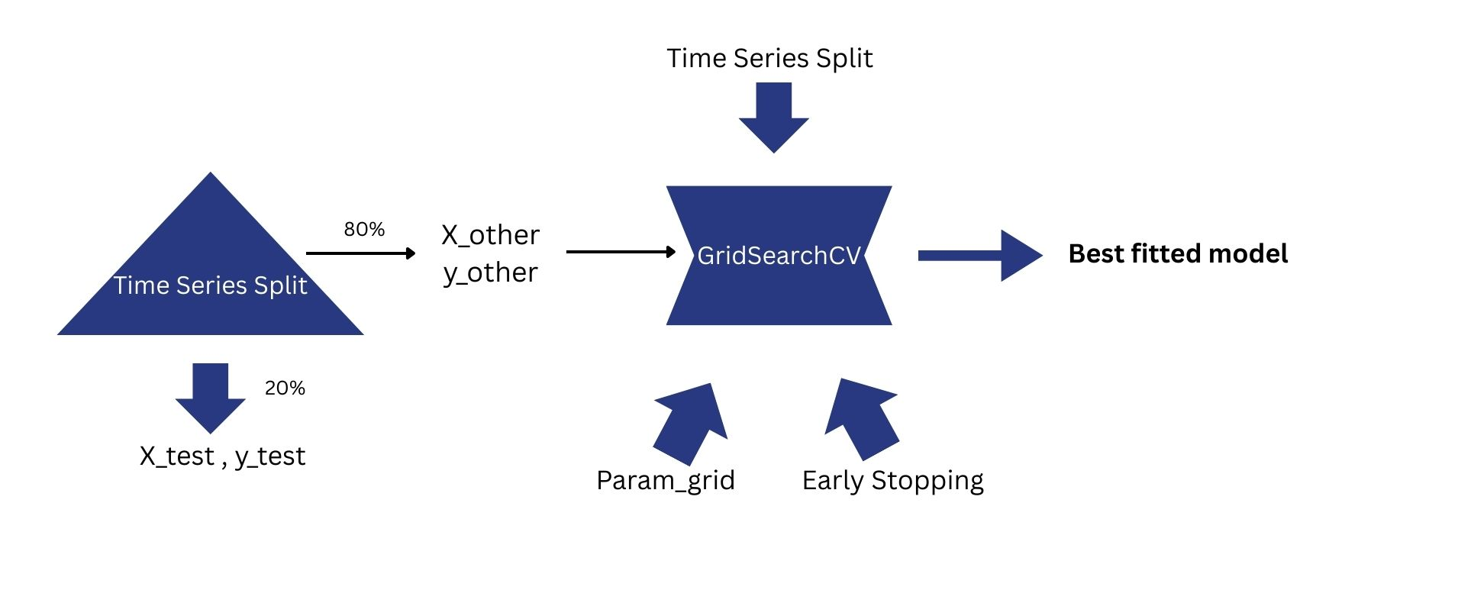
Cross Validation
Splitting/CV: Several lags tried

Slide 6
Cross Validation
Model | Hyper Parameters
Lasso Regression | alpha max_iter
Ridge Regression | alpha solver max_iter
Random Forest | Max_depth random_state
XGBoost | n_estimators alpha lambda max_depth seed learning_rate subsample colsample_bytree missing
Algorithms/ Parameters:

Slide 7
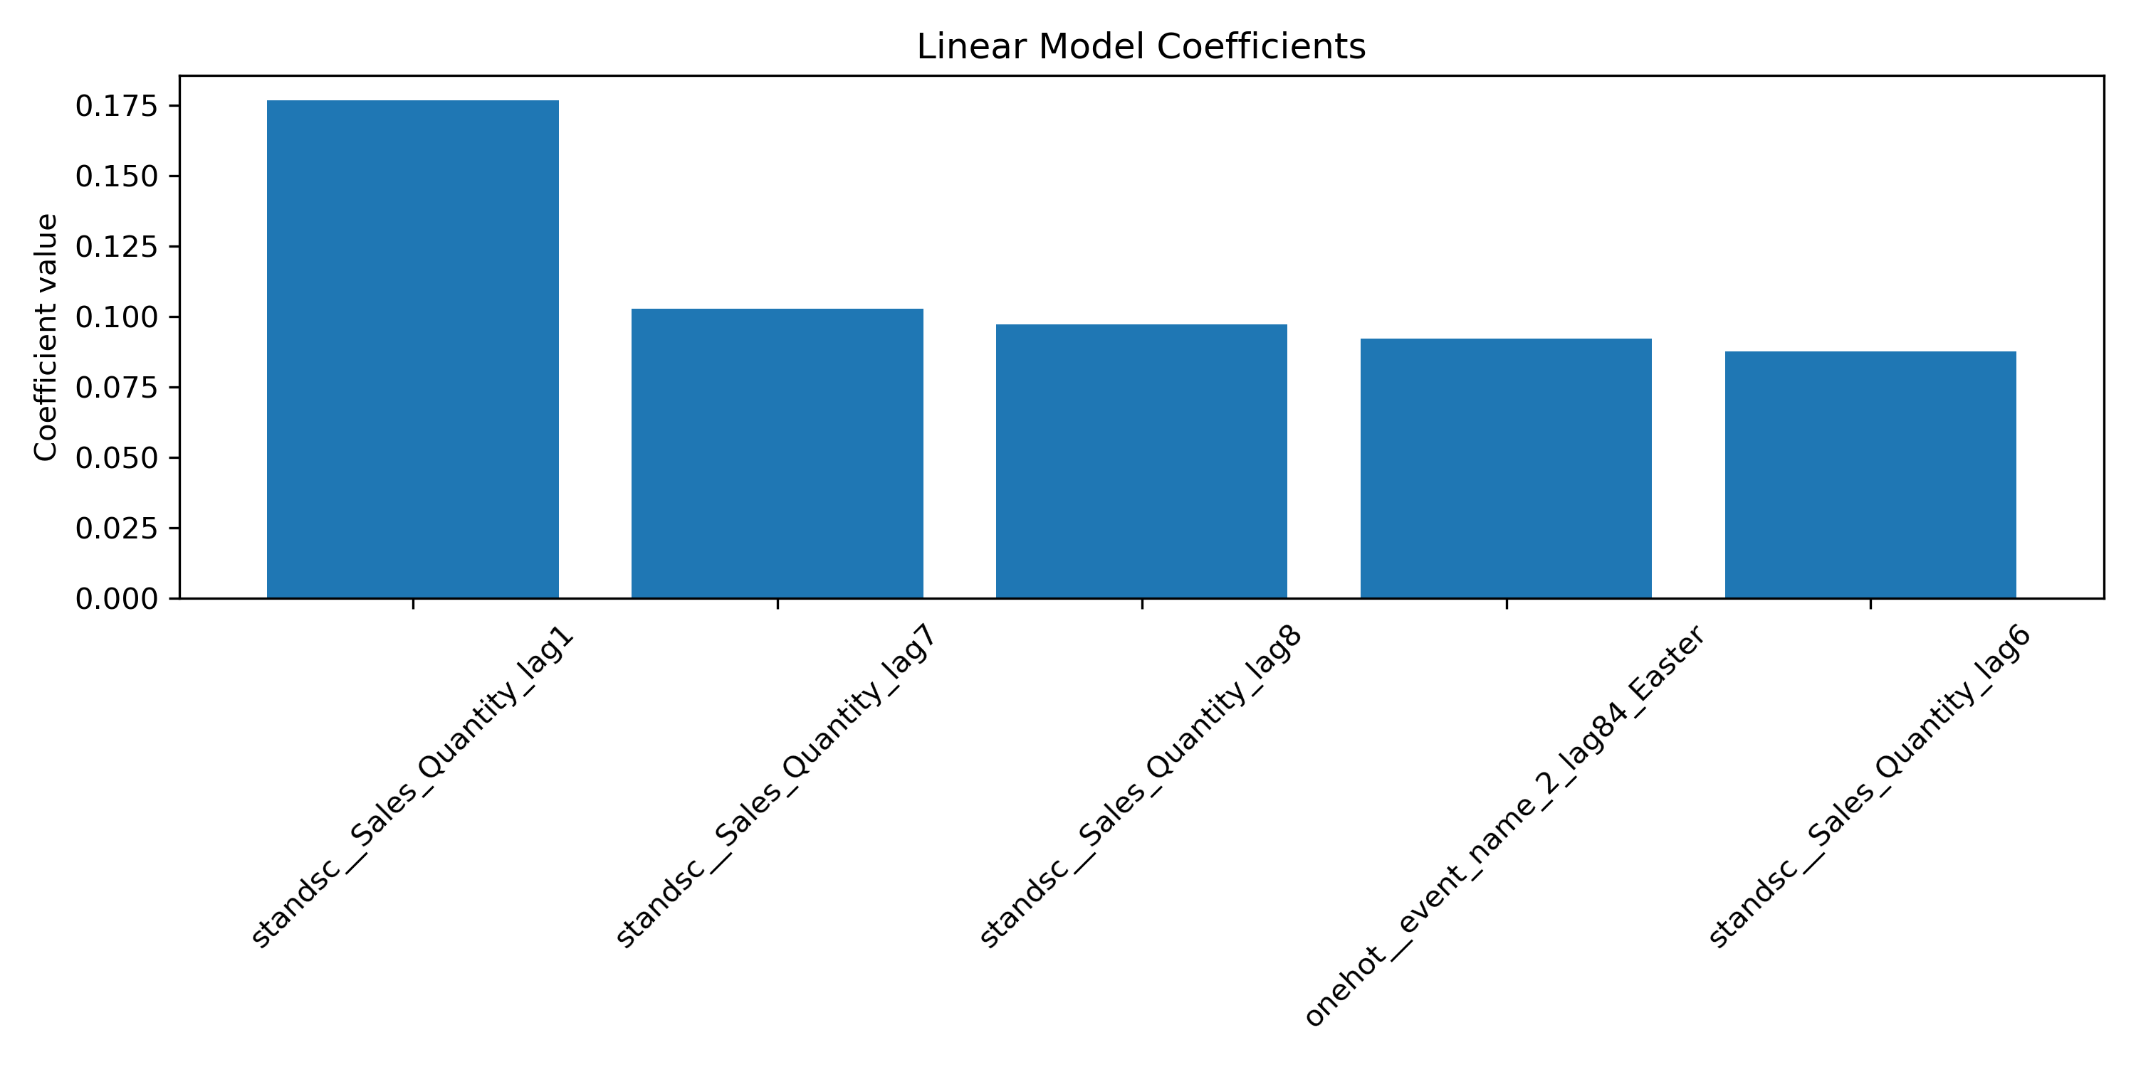
Results

Slide 8
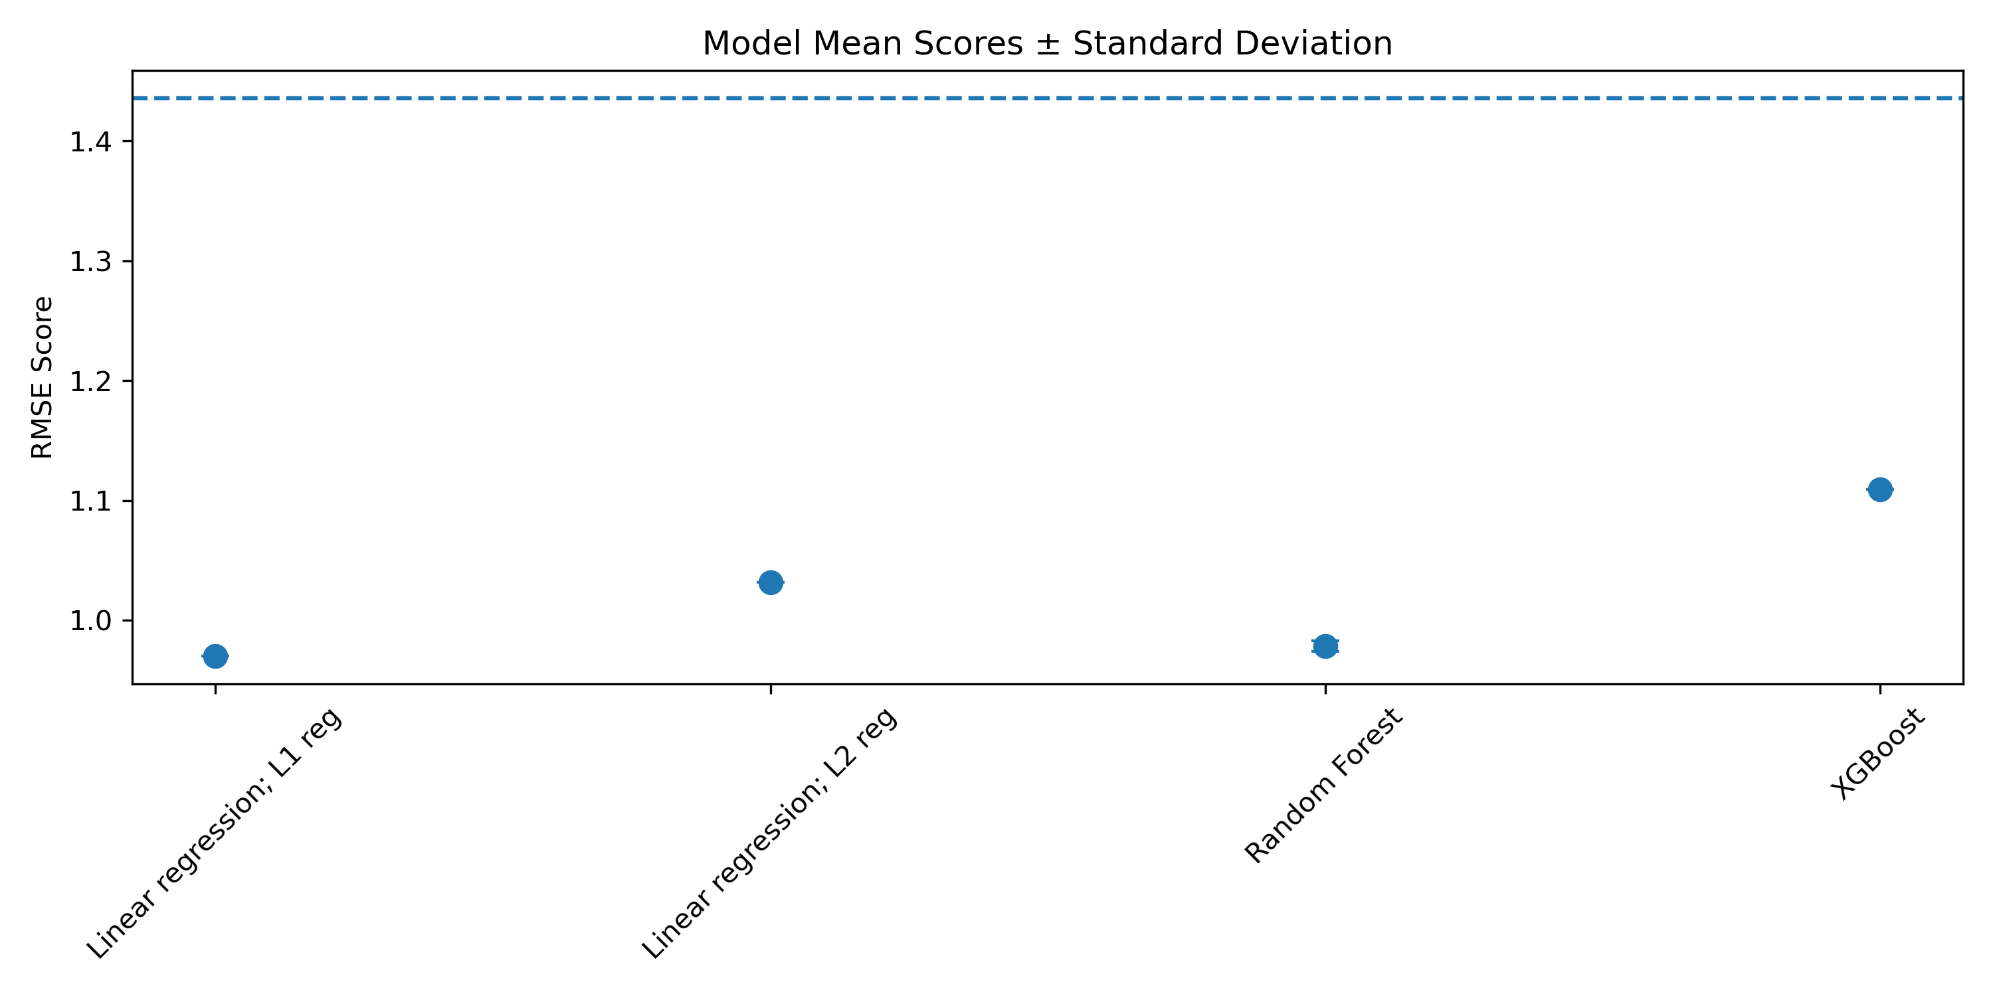
Results
Very complex models are not always the answer

Slide 9
Outlook
Sales
ΔSales
Prediction error feature
GOAL:
Predict change in sales instead
AR I MA X
Lagged features
Other features: price, event...

